Slide 1
OWASP - Central Pennsylvania
Founded by Nathan Cooper and Joe Oriel

Slide 2

Admin notes
Restrooms
Snacks, Water, Soda – Please dispose of your trash
Emergency Exits
5-10min break every 30 – 40 minutes

Slide 3
Today’s Agenda
Intro’s
Who is OWASP
OWASP Membership
OWASP – Projects
Central PA Chapter
Why , Goals, Future
Bug Bounty – Programs
OWASP – Top 10
XSS
Networking

Slide 4
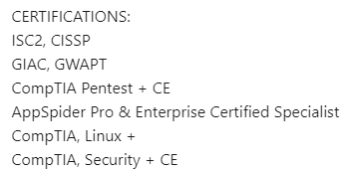





WHOAMI – Nathan Cooper
Started my IT carrier in 1999
Army → 2010 Government Work → 2015 Geisinger Health - Pentester
Passion for Security, Hacking
Wife + 4 kids =
Hobbies - Interests

Slide 5
WHOAMI – Joe oriel
Degree in Digital Forensics from Bloomsburg University
Started working for Geisinger in 2016
Originally from Lehighton pa
Member of the Incident Response Team specializing in next generation endpoint protection
Enjoy any outdoor activity and wood/metal working

Slide 6

OWASP
2018
Notes:
TJB - These slides are linked to EVERY chapter around the world and should be presented at OWASP AppSec Conferences and OWASP Chapters to help explain how the platform of the OWASP Foundation operates and provides services to existing and future members and supporters.
If you are reading this…. And find a ERROR you can MAKE THE CHANGE OR you can notify the owasp foundation to make the change and a member will do so accordingly. CONTACT US
Direct link to these slides if you want to share them = https://docs.google.com/presentation/d/10wi1EWFCPZwCpkB6qZaBNN8mR2XfQs8sLxcj9SCsP6c/edit?usp=sharing

Slide 7

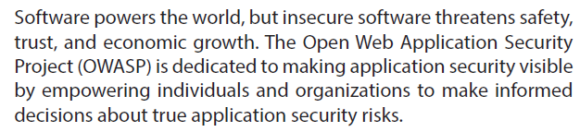
Who is OWASP?
Notes:
TJB- OWASP is a global community that drives the visibility and evolution in the safety and security of the world’s software.
Everyone is free to participate in OWASP and all of our materials are available under a free and open software licenses.
OWASP is a registered nonprofit in the United States and Europe, so all of your financial contributions are tax deductible.

Slide 8
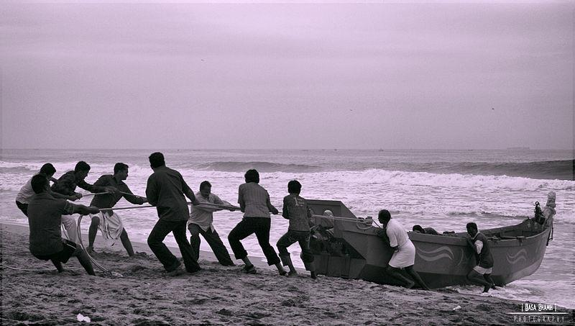
94% think volunteering adds to the skills of their workforce
58% say voluntary work can be more valuable than experience gained in paid employment
25% offer paid time off to employee volunteers
15% allow sabbaticals for volunteering projects
Employer supported volunteering can help a company’s:
Reputation and credibility
Recruitment and staff retention
Staff morale and work performance
Training and development
Change management
Government and regulatory relations..
*Reed Executive
The value of volunteerism
Notes:
1/17/217 TJB Slides updated with stats from reed report.
A recent survey carried out by TimeBank through Reed Executive showed that among 200 of the UK's leading businesses
94% think volunteering adds to the skills of their workforce
58% say voluntary work can be more valuable than experience gained in paid employment
25% offer paid time off to employee volunteers
15% allow sabbaticals for volunteering projects.
Employer supported volunteering can help a company’s:
Reputation and credibility
Recruitment and staff retention
Staff morale and work performance
Training and development
Change management
Government and regulatory relations.

Slide 9
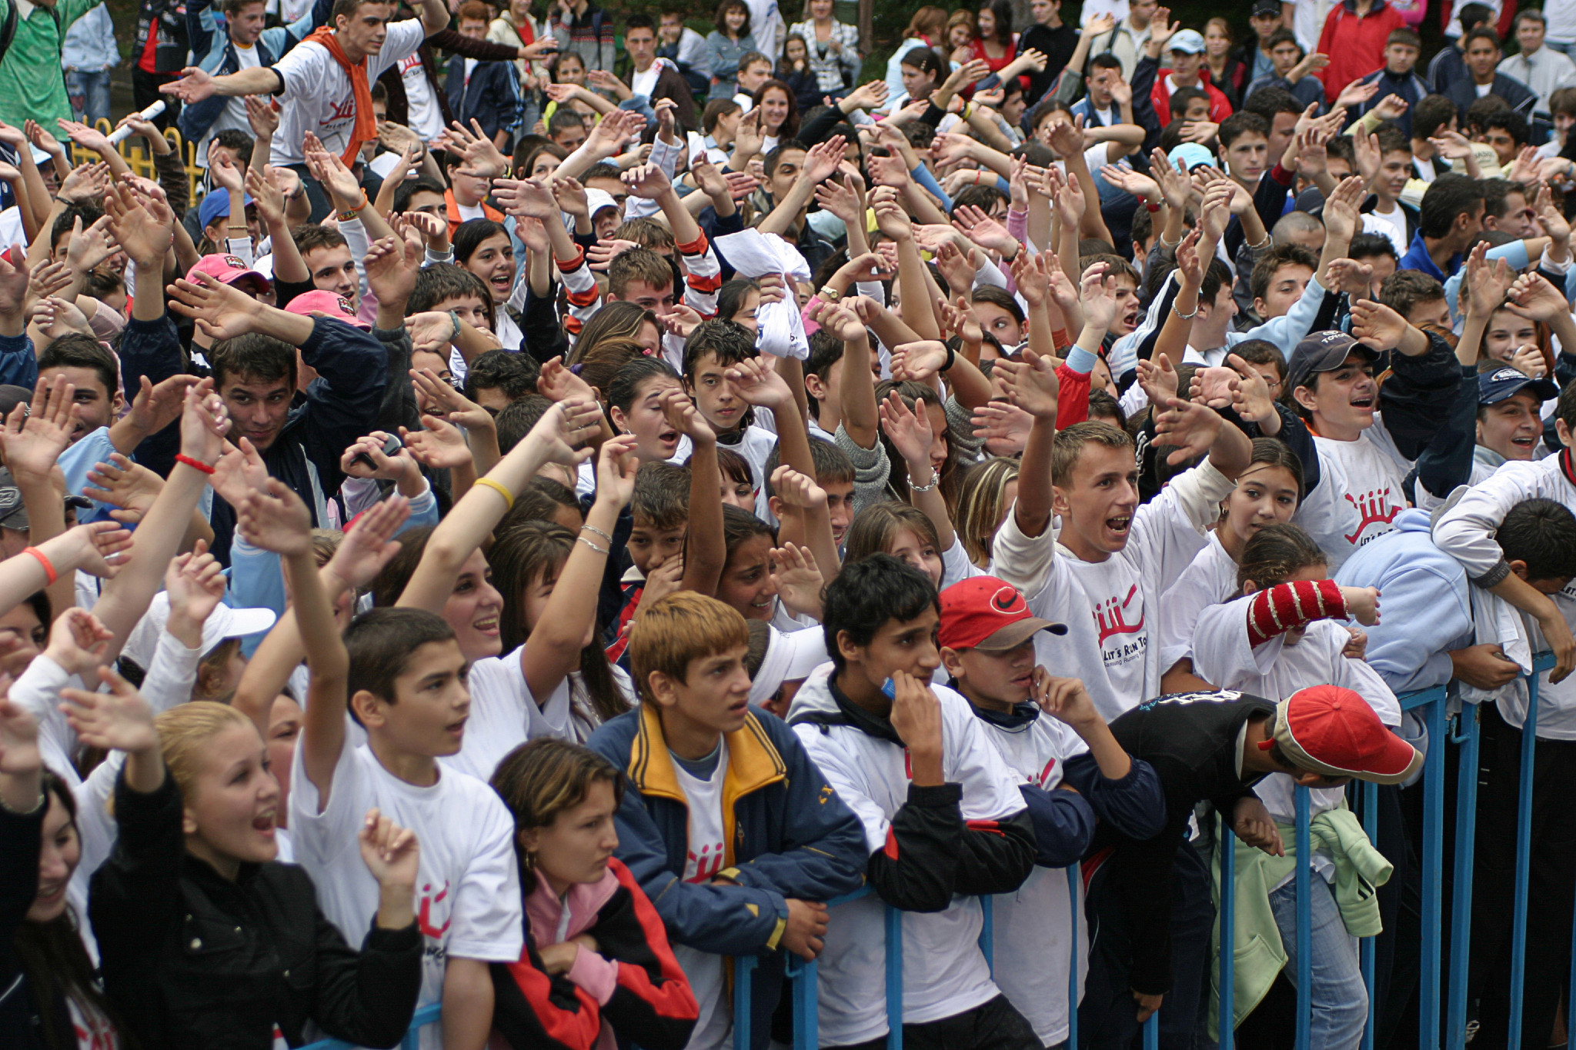
Show of hands
Notes:
NOTE: Gathering demographic information helps owasp to increase sponsorship please pass what you learn onto the operations team and Board.
Now that you know a bit about OWASP, we would like to know a bit about you. Demographics from developers to CIO's are important to highlight as the community has many people that make it successful. By show of hands:
First OWASP Meeting, Event, Conference?
Volunteer Project Leaders?
Volunteer Chapter Leaders?
Commercial
Government
Developers?
Architects?
Pen-testers?
CIO's?
Question
Has the OWASP Foundation provided your corporation or professional value with guides, tools and community?

Slide 10

16
Years of community service
Notes:
16 Years YOUNG is the collective group. We have many groups popping up around us like IEEE, BSides, ISSA, ISACA, ISC2, Defcon, 2600 etc... we share one common bond - community. (Jan 2001-Current)
What will software look like in 20 years?

Slide 11

OWASP's DNA
Notes:
OWASP values people over profits.
And we derive our core values from this DNA. OWASP's Core Values are:
OPEN Everything at OWASP is radically transparent from our finances to our code.
INNOVATION OWASP encourages and supports innovation/experiments for solutions to software security challenges.
GLOBAL OWASP is inclusive not exclusive. Anyone around the world is free to participate in the OWASP community.
INTEGRITY OWASP is an honest and truthful, vendor agnostic, global community.

Slide 12
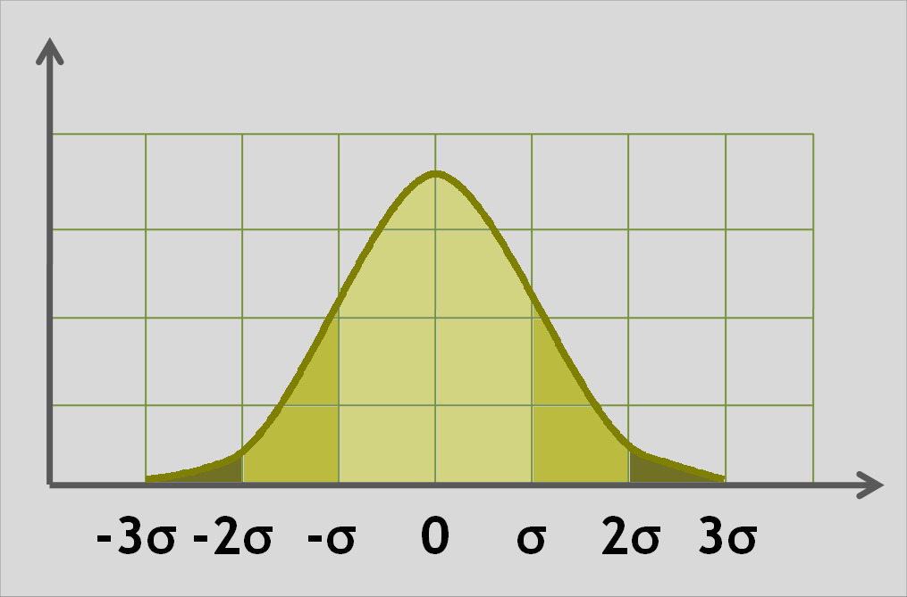
OWASP
by the numbers
Notes:
NOTES TO SPEAKER:
Slides 5-19 are intended to be gone through quickly.
This is why there are limited speaker notes.
The speaker is free to comment about each of the slides / ideas as the speaker chooses.

Slide 13

2,005,000
owasp.org page views (per month)
Notes:
Thanks to Javascipt and Google Analytics ;)
2013: 1,370,000
2016: 2,005,071

Slide 14
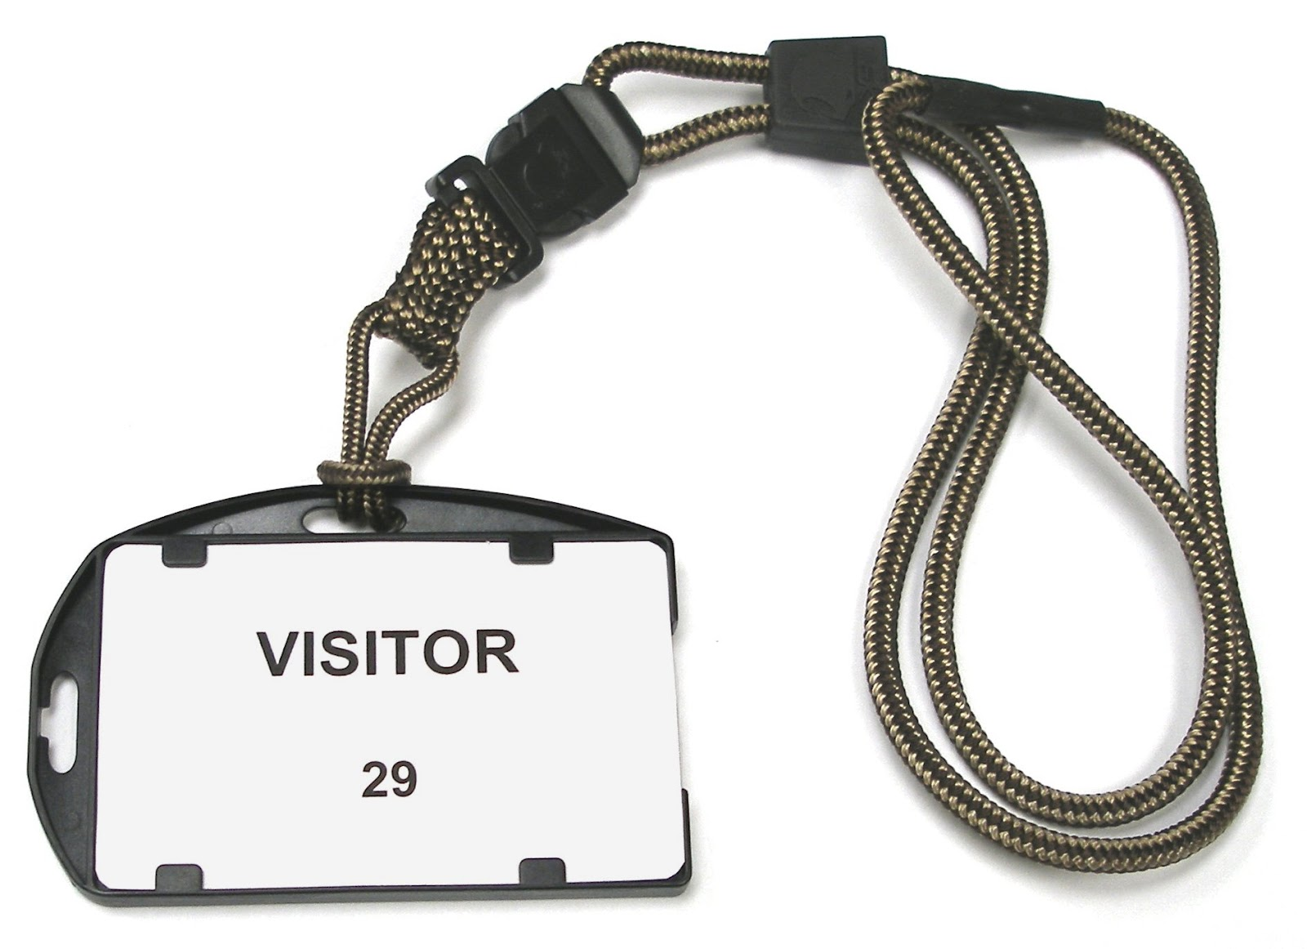
650,000 / 1M
owasp.org unique visitors/sessions per month
Notes:
2013: 400,100
2016: 649, 506 unique visitors and 1,034,253 unique sessions/month

Slide 15
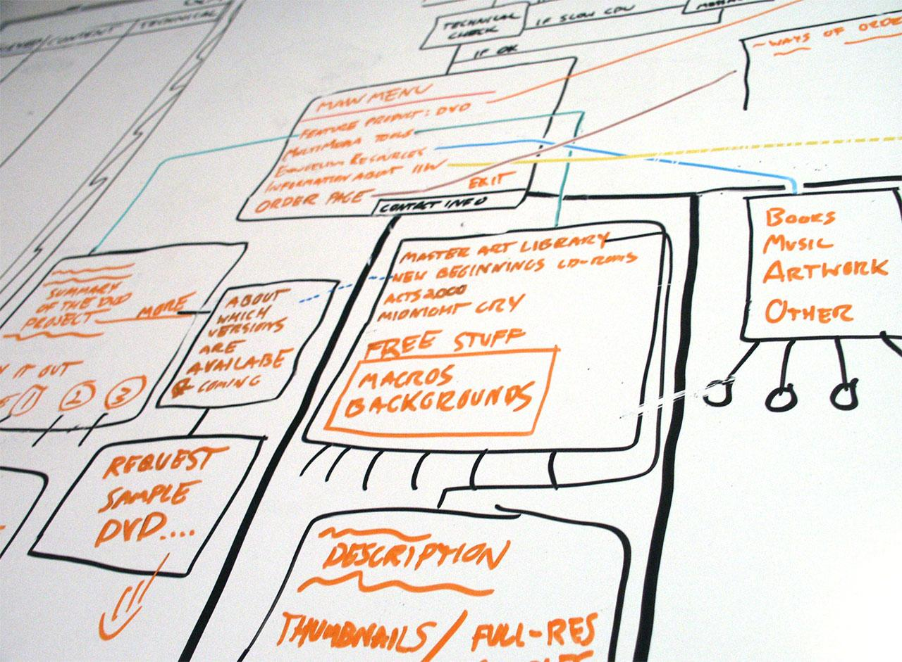
93
Active Projects
Notes:
Total Count is 93 (as of 1/18/2017) - Matt Tesauro
13 Flagships
5 Tool Projects
3 Code Projects
5 Documentation Projects
37 Labs
17 Tool Projects
4 Code Projects
16 Documentation Projects
43 Incubators
19 Tool Projects
8 Code Projects
16 Documentation Projects
From Johana’s 2015 report as of March.
Current Active Projects: 126
Incubator - 97
Labs - 26
Flagship - 3
Projects by Type:
19 Code projects
40 Documentation Projects
53 Tool Projects

Slide 16
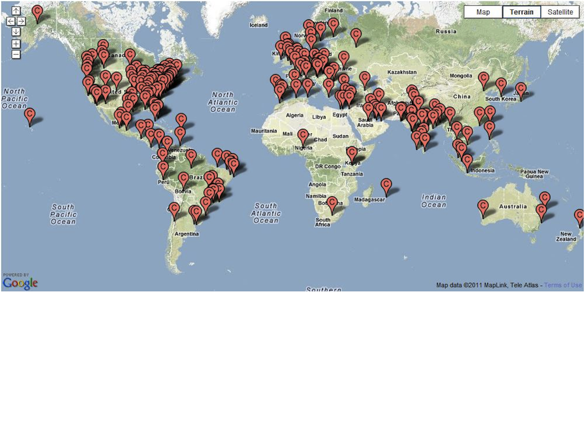
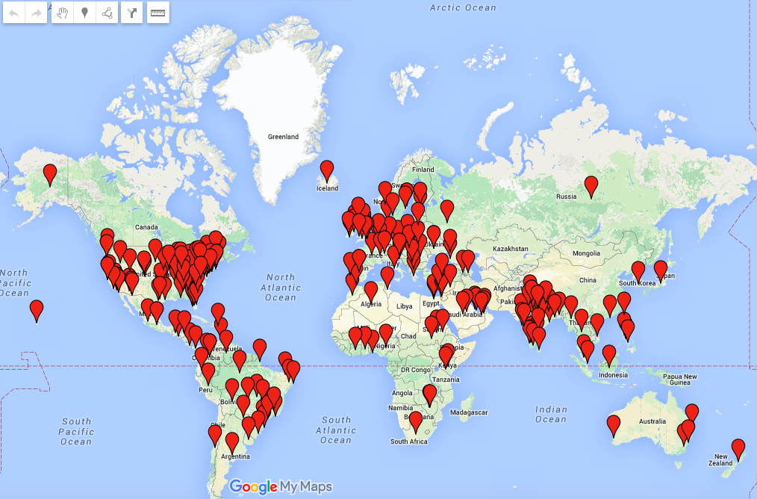
276
Active Chapters
Notes:
From Sarah’s roll-up report August 11 2013.
New Chapters August 2013: 1
Azerbaijan (Middle East) - lead by Adil Aliyev
How many countries?
as of 4/2/2015
108 as of 1/4/2017

Slide 17

55,000+
participants mailing lists
Notes:
Updated to 36k - TJB 19-Feb
2013: 43,000
ye2014: 44,000
Ye 2016: 55,000
As of 2017-01-17:
Total number of lists: 882
Top 3 lists that are not chapters
owasp-modsecurity-core-rule-set 1,008 members
owasp-testing 979 members
owasp-topten 694
Top 3 lists overall
owasp-new-york 1,917 members
owasp-nynjmetro 1,736 members
owasp-twincities 1,500 members

Slide 18

129+
Government & Industry Citations!
Notes:
Does Industry & Government think our materials are creditable?
NOTE: pick a few that you find interesting, (delete the rest) no need to name them all...
Canadian Cyber Incident Response Centre, Center for Internet Security (CIS), Centre for the Protection of National Infrastructure (CPNI), Cloud Security Alliance (CSA), Defense Information Systems Agency (DISA), European Network and Information Security Agency (ENISA), Federal Financial Institutions Examination Council (FFIEC), Federal Trade Commission (FTC), Financial Services Roundtable, GovCertUK, Institute of Electrical and Electronics Engineers (IEEE), International Organization for Standardization (ISO) and International Electrotechnical Commission (IEC), National Cyber Security Division, National Institute of Standards and Technology (NIST), National Security Agency/Central Security Service, Payment Card Industry Security Standards Council (PCI SSC), SANS Institute, Software Engineering Institute (SEI), Trusted Information Sharing Network for Critical Infrastructure Protection (TISN), World Wide Web Consortium (W3C), Australian Computer Emergency Response Team (AusCERT), Canadian Cyber Incident Response Centre, Combined Security Incident Response Team (CSIRTUK), Information Assurance Technology Analysis Center (IATAC), Data and Analysis Center for Software (DACS).
And in September the Department of Homeland Security (DHS)!
88 as of 2013
126 as of 03/31/2015
Source:
https://www.owasp.org/index.php/Industry:Citations

Slide 19

25
Academic Supporters
Notes:
TJB Updated https://www.owasp.org/index.php/Membership#tab=Corporate_Supporters
Are you a alumni? Do you give back to your college - bring them OWASP via or Academic Supporters program. Academics supporters provide space for chapter or student chapter meetings and provide feedback on our educational materials as well as conversation around application security curriculum development.
We are currently revising our Academic Supporters program. In the past we have had over 100 universities and schools listed as academic supporters.
2015 - 9
2016 - 20
8 reported active/confirmed as of 3/31/2015

Slide 20

68
Paid Corporate Memberships
Notes:
Corporate Supporters -- Industry providers such as UPS, BestBuy, HP, Oracle, Twitter, and many technology service providers including Rackspace thank you for hosting the website btw (count from https://www.owasp.org/index.php/Main_Page)
Source: https://www.owasp.org/index.php/February_2015_Membership_Report
Ye 2016: 71 corp supporters (9 premier and 62 contributor)
TJB Updated as of 1/17 https://docs.google.com/spreadsheets/d/1uirL5Ew7WID1-mwdx5GVDeF2f8KwvuXG1JZ05e6rv2k/edit#gid=0

Slide 21
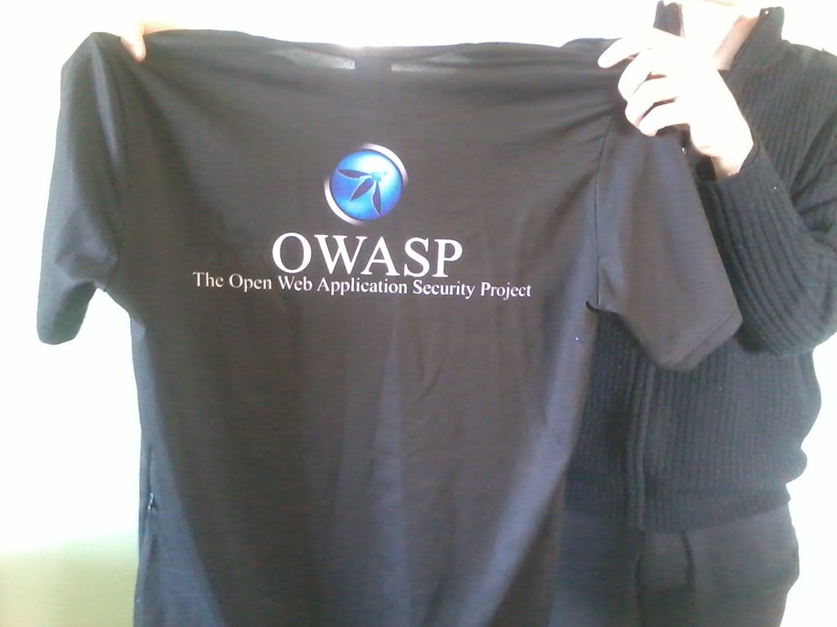
2406
Individual Members
Notes:
http://owasp.com/index.php/July_2013_Membership_Report
TJB updated as of https://docs.google.com/spreadsheets/d/1uirL5Ew7WID1-mwdx5GVDeF2f8KwvuXG1JZ05e6rv2k/edit#gid=0

Slide 22

2018 Global Board of Directors
– Chairperson: Martin Knobloch, Netherlands
– Vice Chairperson: Chenxi Wang, California, USA
– Secretary: Owen Pendlebury, Dublin, Ireland
– Treasurer: Andrew van der Stock, California, USA
– Board Member: Matt Konda, California, USA
– Board Member: Greg Anderson, Texas, USA
– Board Member: Sherif Mansour, London, United Kingdom

Slide 23
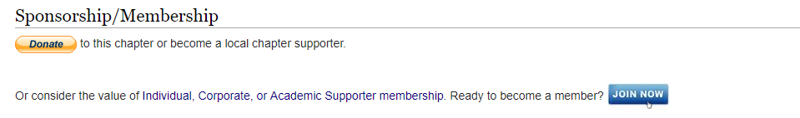
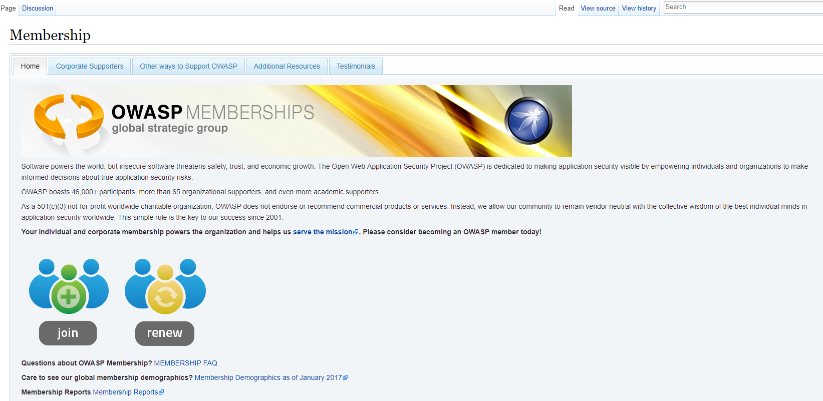
OWASP Membership
https://www.owasp.org/index.php/Central_Pennsylvania#OWASP_Central_Pennsylvania
https://www.owasp.org/index.php/Membership

Slide 24
OWASP EMAIL List
Sign Up - https://lists.owasp.org/mailman/listinfo/owasp-centralpennsylvania
Future – Meetups -???

Slide 25
OWASP Projects – Flag ship
OWASP Zed Attack Proxy Project - https://www.owasp.org/index.php/OWASP_Zed_Attack_Proxy_Project
OWASP Testing Guide - https://www.owasp.org/index.php/OWASP_Testing_Project
OWASP Top 10 –Web App https://www.owasp.org/index.php/Category:OWASP_Top_Ten_Project
OWASP Top 10 – Mobile
https://www.owasp.org/index.php/OWASP_Mobile_Security_Project
OWASP – Juice Shop - https://www.owasp.org/index.php/OWASP_Juice_Shop_Project
OWASP – Checklists – Best Practices, Cheat Sheets, Secure Coding by language etc..
Google: OWASP Checklist

Slide 26
Why we started the chapter
????
Notes:
Collaboration
Lessons learned
Community to ask questions
Learn, share ideas
Surround myself with others passionate about what they do

Slide 27
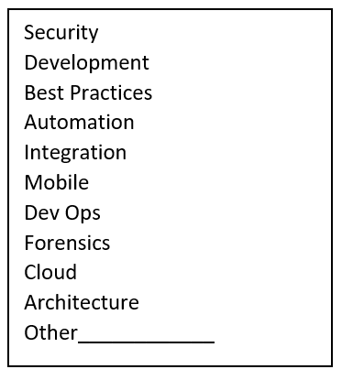
Chapter Goals - Future
OWASP requirement - 4 meetings a year to maintain the chapter
Meetings moving forward - vote
OWASP Top 10
Collaboration
Networking
Notes:
Meetings how often – how long? – Who is willing to teach/share something?
Circle 3 that you are most interested in

Slide 28


Bug Bounty Programs
https://www.hackerone.com/
YouTube
Free training
Community
https://www.bugcrowd.com/
YouTube
Free training
Community

Slide 29

OWASP Top-10 2017

Slide 30
About the OWASP Top 10
OWASP Top 10 is an Awareness Document
Not a standard…
First developed in 2003
Was probably 3rd or 4th OWASP project, after
Developers Guide
WebGoat
WebScarab ??
Released
2003, 2004, 2007, 2010, 2013, 2017

Slide 31
OWASP Top Ten (2017 Edition)
A1: Injection
A10: Insufficient Logging & Monitoring
A5: Broken Access Control
A3: Sensitive Data Exposure
A2: Broken Authentication
A4: XML External Entities (XXE)
A7: Cross-Site Scripting
A6: Security Misconfiguration
A8: Insecure Deserialization
A9: Using Components with Known Vulnerable
Notes:
A9 is the only new item in the top 10 for 2013.

Slide 32
Vulnerabilities By Industry
What do you think the most common vulnerability is?

Slide 33
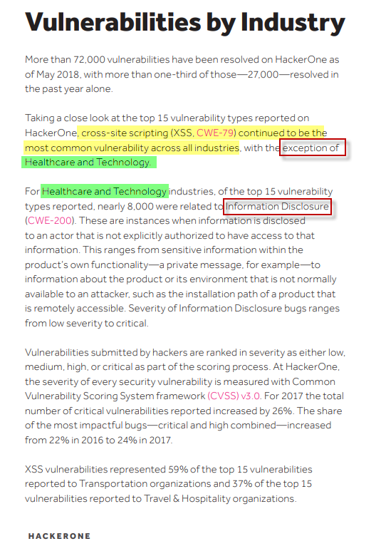

Vulnerabilities By Industry

Slide 34
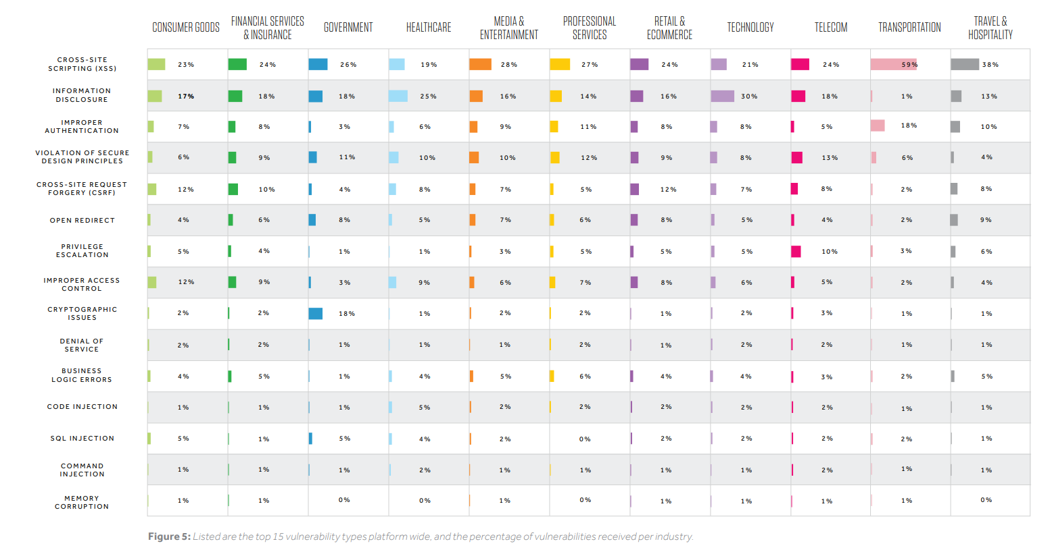

Slide 35
Risks
It’s About Risks, Not Just Vulnerabilities
OWASP Top 10 Risk Rating Methodology
Title is: “The Top 10 Most Critical Web Application Security Risks”
Based on the OWASP Risk Rating Methodology, used to prioritize Top 10

Slide 36
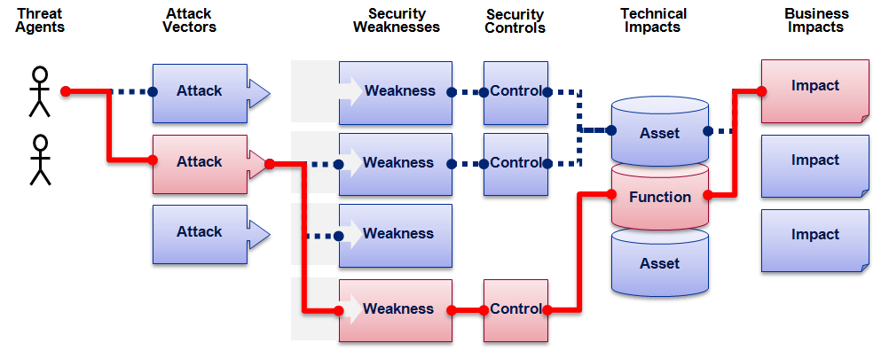

OWASP Top 10 Risk Rating Methodology
Threat Agent | Attack Vector | Weakness Prevalence | Weakness Detectability | Technical Impact | Business Impact
? | Easy | Widespread | Easy | Severe | ?
 | Average | Common | Average | Moderate
 | Difficult | Uncommon | Difficult | Minor
 | 1 | 2 | 2 | 1
 |  | 1.66 | * | 1
1
2
3
Injection Example
1.66 weighted risk rating

Slide 37
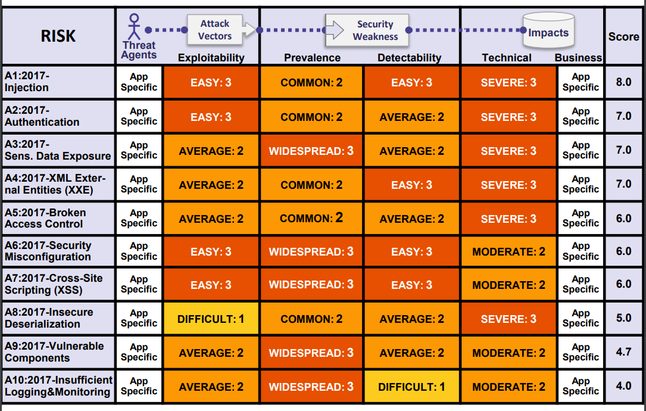
Top 10 Risk Factor Summary

Slide 38
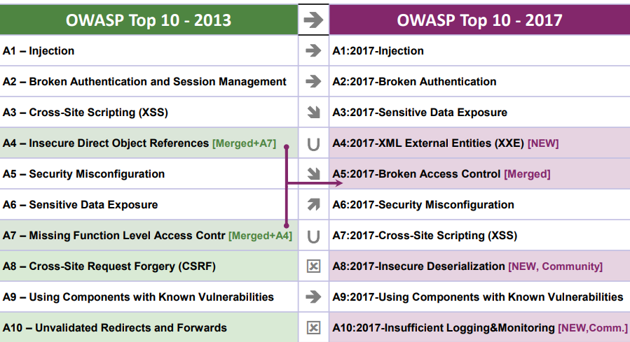
Mapping from 2013 to 2017 Top 10

Slide 39
2017-A1 – Injection
Injection flaws
occur when untrusted data is sent to an interpreter as part of a command or query. The attacker’s hostile data can trick the interpreter into executing unintended commands or accessing data without proper authorization.
Examples:
SQL
NoSQL
OS
LDAP injection

Slide 40
2017-A2 – Broken Authentication
Broken Authentication
Application functions related to authentication and session management are often implemented incorrectly, allowing attackers to compromise passwords, keys, or session tokens, or to exploit other implementation flaws to assume other users’ identities temporarily or permanently.

Slide 41
2017-A3 – Sensitive Data Exposure
Sensitive Data Exposure
Many web applications and APIs do not properly protect sensitive data, such as financial, healthcare, and PII. Attackers may steal or modify such weakly protected data to conduct credit card fraud, identity theft, or other crimes. Sensitive data may be compromised without extra protection, such as encryption at rest or in transit, and requires special precautions when exchanged with the browser.

Slide 42
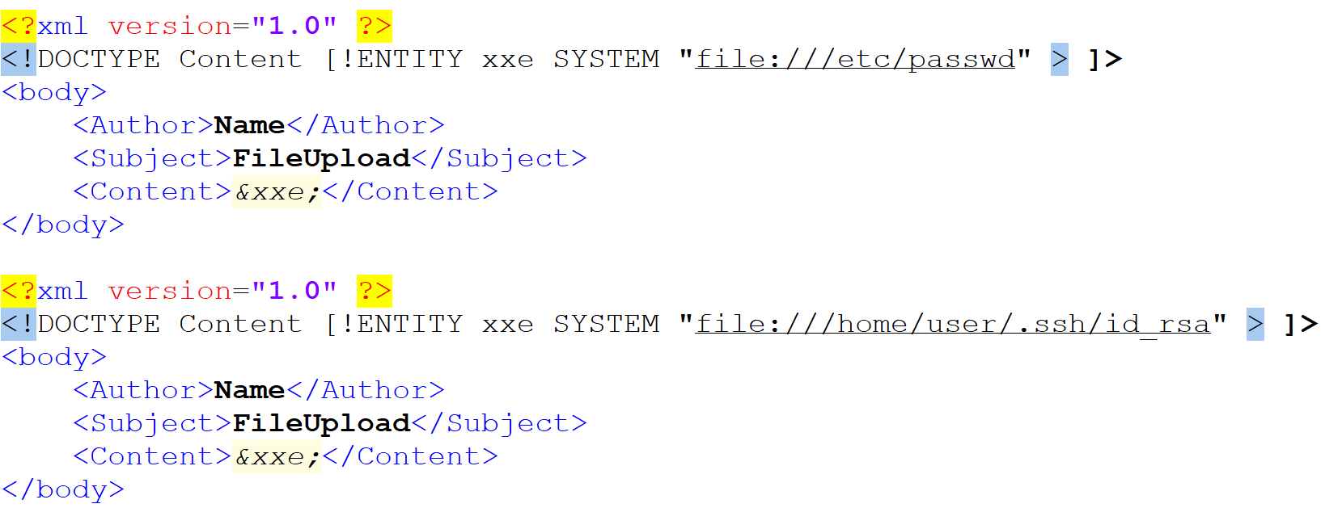
2017-A4 – XML External Entities (XXE)
XML External Entities (XXE)
Many older or poorly configured XML processors evaluate external entity references within XML documents. External entities can be used to disclose internal files using the file URI handler, internal file shares, internal port scanning, remote code execution, and denial of service attacks.

Slide 43
2017-A5 – Broken Access Control
Broken Access Control – Access is already granted
Restrictions on what authenticated users are allowed to do are often not properly enforced. Attackers can exploit these flaws to access unauthorized functionality and/or data, such as access other users' accounts, view sensitive files, modify other users’ data, change access rights, etc.

Slide 44
2017-A6 – Security Misconfigurations
Security Misconfigurations
is the most commonly seen issue. This is commonly a result of insecure default configurations, incomplete or ad hoc configurations, open cloud storage, misconfigured HTTP headers, and verbose error messages containing sensitive information. Not only must all operating systems, frameworks, libraries, and applications be securely configured, but they must be patched and upgraded in a timely fashion.

Slide 45
2017-A7 – Cross-Site Scripting (XSS)
Cross-Site Scripting (XSS)
XSS flaws occur whenever an application includes untrusted data in a new web page without proper validation or escaping, or updates an existing web page with user-supplied data using a browser API that can create HTML or JavaScript. XSS allows attackers to execute scripts in the victim’s browser which can hijack user sessions, deface web sites, or redirect the user to malicious sites.

Slide 46
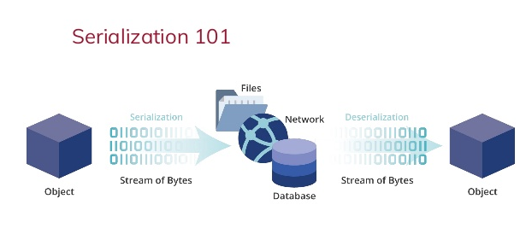
2017-A8 – Insecure Deserialization
Insecure Deserialization
Insecure deserialization often leads to remote code execution. Even if deserialization flaws do not result in remote code execution, they can be used to perform attacks, including replay attacks, injection attacks, and privilege escalation attacks.
Serialization is a process of converting an object into a sequence of bytes which can be persisted to a disk or database or can be sent through streams. The reverse process of creating object from sequence of bytes is called deserialization.

Slide 47
2017-A9-Using Components with Known Vulnerabilities
Using Components with Known Vulnerabilities
Components, such as libraries, frameworks, and other software modules, run with the same privileges as the application. If a vulnerable component is exploited, such an attack can facilitate serious data loss or server takeover. Applications and APIs using components with known vulnerabilities may undermine application defenses and enable various attacks and impacts.

Slide 48
2017-A9-Insufficient Logging & Monitoring
Insufficient Logging & Monitoring
Insufficient logging and monitoring, coupled with missing or ineffective integration with incident response, allows attackers to further attack systems, maintain persistence, pivot to more systems, and tamper, extract, or destroy data. Most breach studies show time to detect a breach is over 200 days, typically detected by external parties rather than internal processes or monitoring.

Slide 49
OWASP Top-10 2017

Slide 50
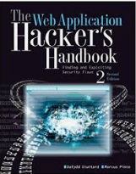
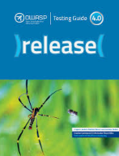
XSS – Cross site Scripting
Recommended Reading –
Web Application Hacker’s Handbook (2nd Edition) - Chapter 12 - Attacking Users: Cross-Site Scripting
OWASP Testing Guide 4.0 - 4.8.1 Testing for Reflected Cross Site Scripting (OTG-INPVAL-001), 4.8.2 Testing for Stored Cross Site Scripting (OTG-INPVAL-002), 4.12.1 Testing for DOM based Cross Site Scripting (OTG-CLIENT-001)
Mozilla Developer Network - Web Docs - Introduction to the DOM
https://developer.mozilla.org/en-US/docs/Web/API/Document_Object_Model/Introduction

Slide 51
XSS – Cross site Scripting
What is XSS?
When/Where do you find it
How do you find it
Impact?
What can you really do with XSS?

Slide 52
XSS – What is xss
Cross-site scripting is one of the oldest web application attacks known and is dated around 1996-1998 when it was possible to control frames within a web page through injected code, thus “crossing” the website boundaries.
Currently, it is still on top of the OWASP Top 10; this clearly goes to show how much of a threat this really is!
is a web application vulnerability that occurs when untrusted data from the user is processed by the web application without validation and is reflected back to the browser without encoding or escaping, resulting in code execution at the browser engine.

Slide 53
XSS – Types
OWASP types - Industry
Reflective or Non-Persistent
Stored
DOM
Additional:
Blind
Flash-based - Adobe
Self
Mutation
RPO – Relative Path Overwrite

Slide 54
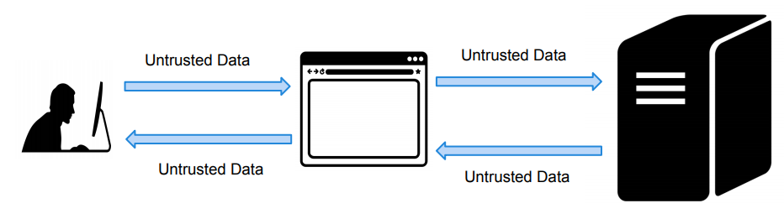
XSS – Types – Reflective
May be called Non-Persistent

Slide 55
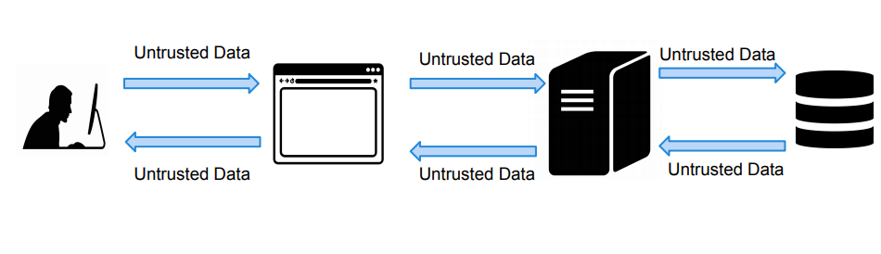
XSS – Types – Stored

Slide 56
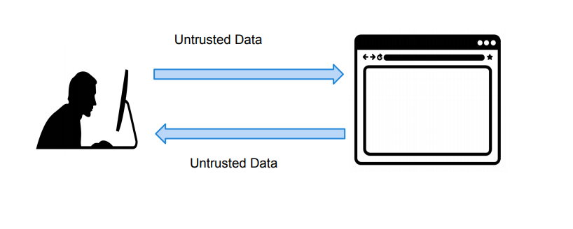
XSS – Types – DOM
Document Object Model - https://developer.mozilla.org/en-US/docs/Web/API/Document_Object_Model/Introduction

Slide 57
XSS – Reflective
Reflective is most basic and easiest to understand
Simplest to discover

Slide 58
XSS – Reflective - Encoding
URL Encoding – or called Percent encoding - Plays an important role
Characters to be encoded - /\=<>?+&”;:
Before - <script>alert(1)</script>
After - %3Cscript%3Ealert%281%29%3C%2Fscript%3E
Http://site.com/?name=<script>alert(1)</script>
Http://site.com/?name= %3Cscript%3Ealert%281%29%3C%2Fscript%3E
May assist in defeating blacklist or whitelist and style filters

Slide 59
XSS – Discovery
Reflection test
Unique string 3133731337
Filter test- what gets encoded vs what doesn’t
()/\=<>?+&”; //{}
Proof of Concept payload
<script>alert(document.domain)</script
<script>alert(31337)</script

Slide 60
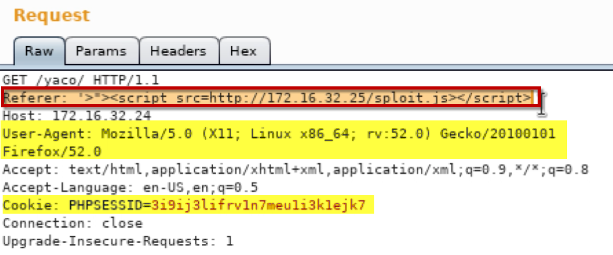
XSS – Injection points
URL query parameters
Search
POST parameters
Forms
Hidden forms
HTTP Headers
Useragent
Referer
Cookies
Context
HTML content = <div><p> Hello, 3133731337</p></div>
Tag attribute= <input type=”text” name=”xss” value=” 3133731337”>
Existing JavaScript Code= <script> var contact==” 3133731337”; …</script>

Slide 61
XSS – Injection points
Context - HTML content
Initial
<div><p> Hello, 3133731337</p></div>
Example Payload
<img src=“x” onerror=alert(31227);/>
Result = error would display the pop up
<div><p> Hello, <img src=“x” onerror=alert(31227);/></p></div>

Slide 62
XSS – Injection points
Context – tag attribute
Initial
<input type=”text” name=”xss” value=”3133731337”>
Example Payload
31337” onload=“alert(31227)
Result
<input type=”text” name=”xss” value=” 3133731337” onload=“alert(31227)”>

Slide 63
XSS – Injection points
Context – JS code
Initial
<script> var contact==” 3133731337”; …</script>
Example Payload
37”;alert(31337);//
Result
<script> var contact==”3133731337”;alert(31337)”;//”; …</script>
; JS line terminator
// single line comment
) closing parenthesis might be needed

Slide 64
XSS – Reflective - Start Slow
HTML injection
<b>Hello</b>
<i>test</i>
<h1 style=-moz-transform:rotate(-180deg);>OWASP</h1>
JavaScript
<
>
<>
<script>
</script>
<script>alert(1)</script>
<script>confirm(1)</script>

Slide 65
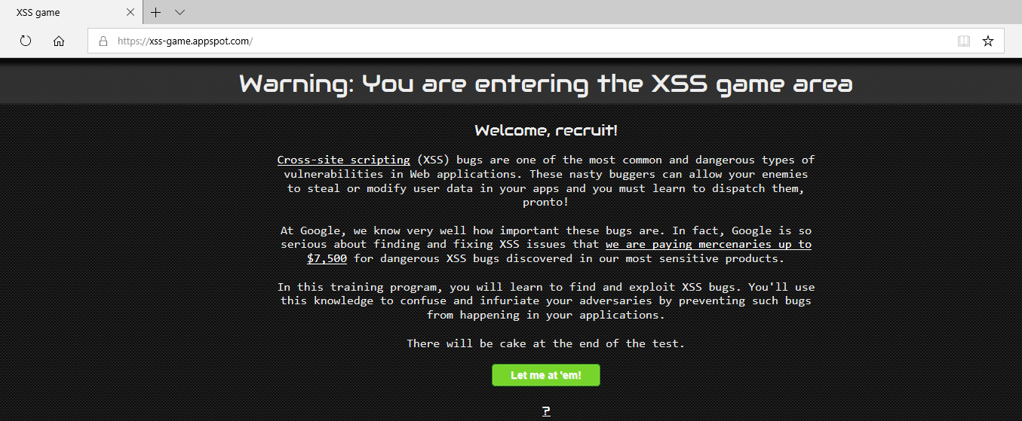
XSS – Types – Reflective
https://xss-game.appspot.com/

Slide 66
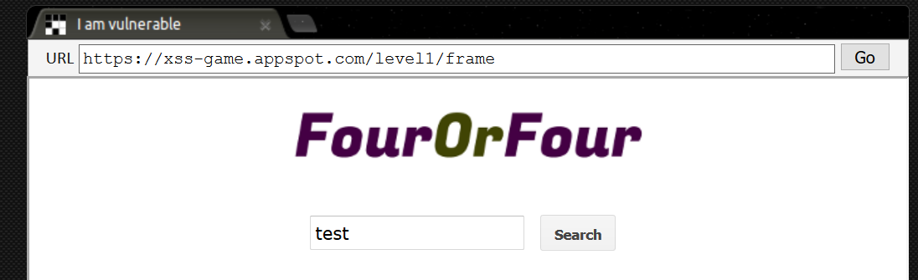
XSS – Types – Reflective

Slide 67
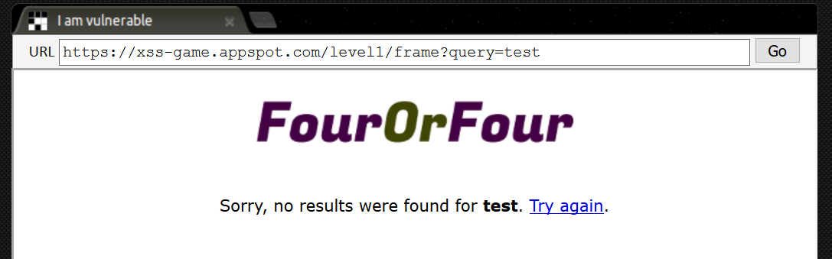
XSS – Types – Reflective

Slide 68
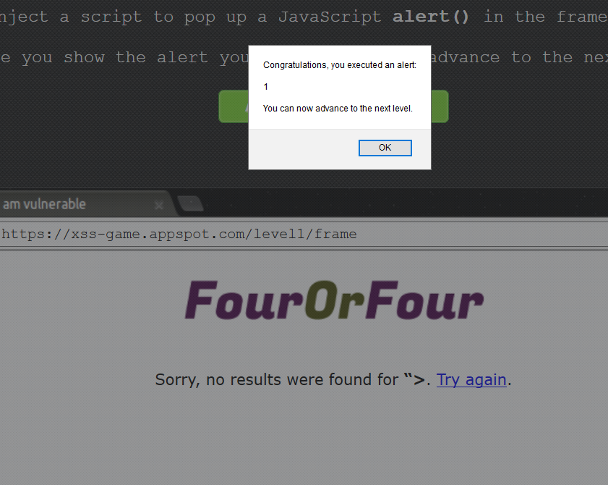
XSS – Types – Reflective
<script>alert(1)</script

Slide 69
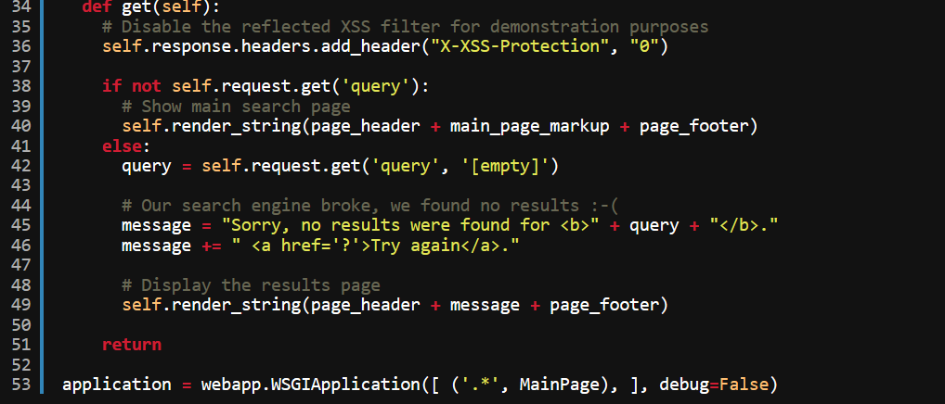
XSS – Types – Reflective

Slide 70
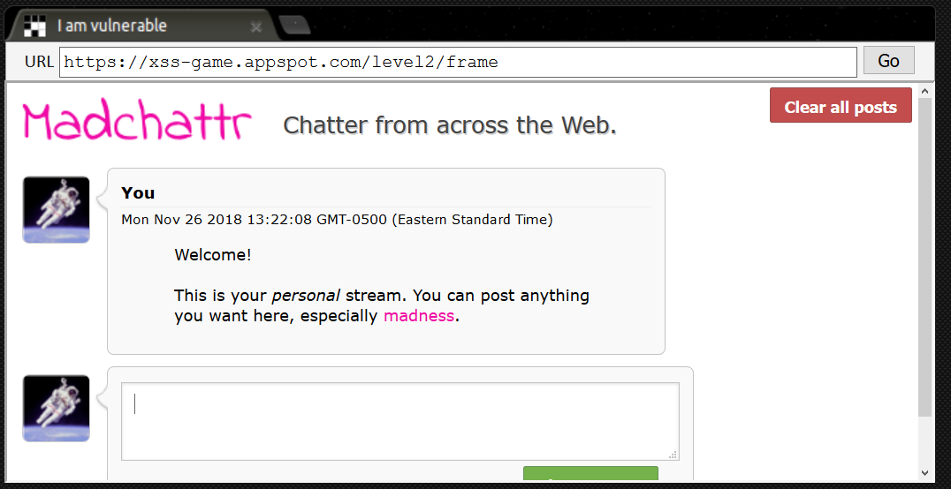
XSS – Types – Reflective

Slide 71
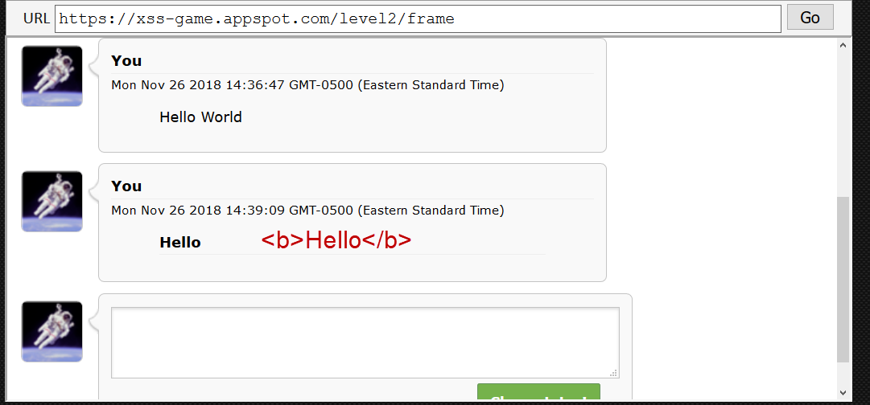
XSS – Types – Reflective

Slide 72
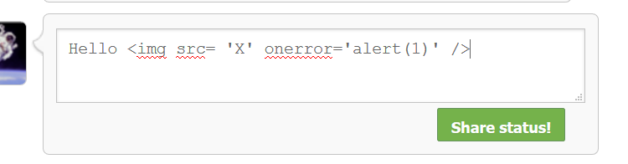
XSS – Types – Reflective
<img src =‘X’ onerror=alert(1) />
Notes:
<img src =‘X’ onerror=‘alert’(1) />

Slide 73
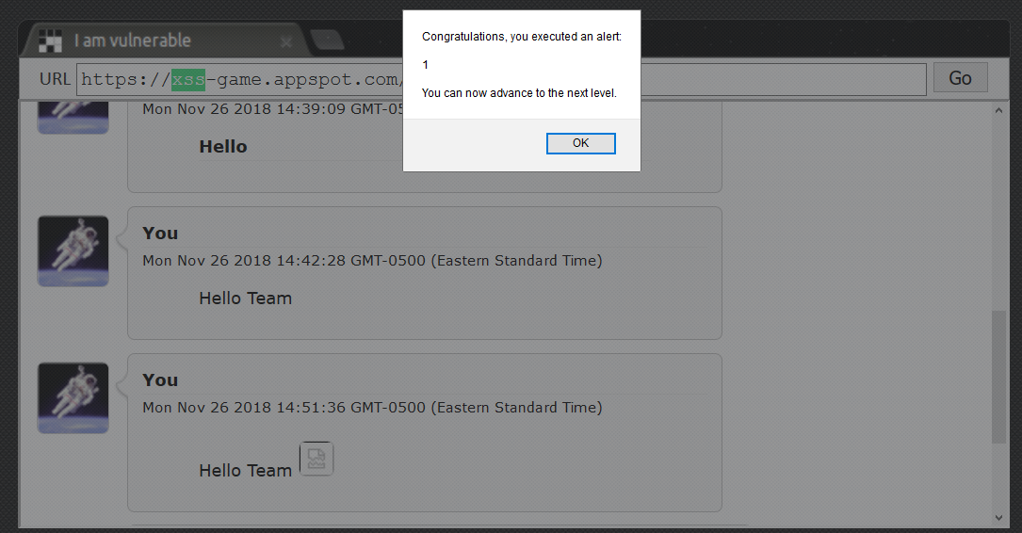
XSS – Types – Reflective

Slide 74
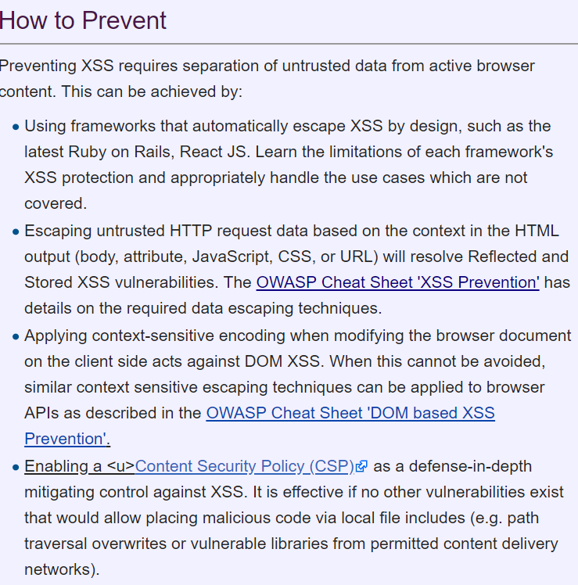
XSS – Prevent

Slide 75
XSS – Types – Reflective

Slide 76
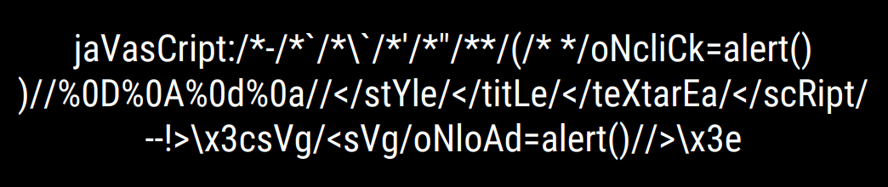
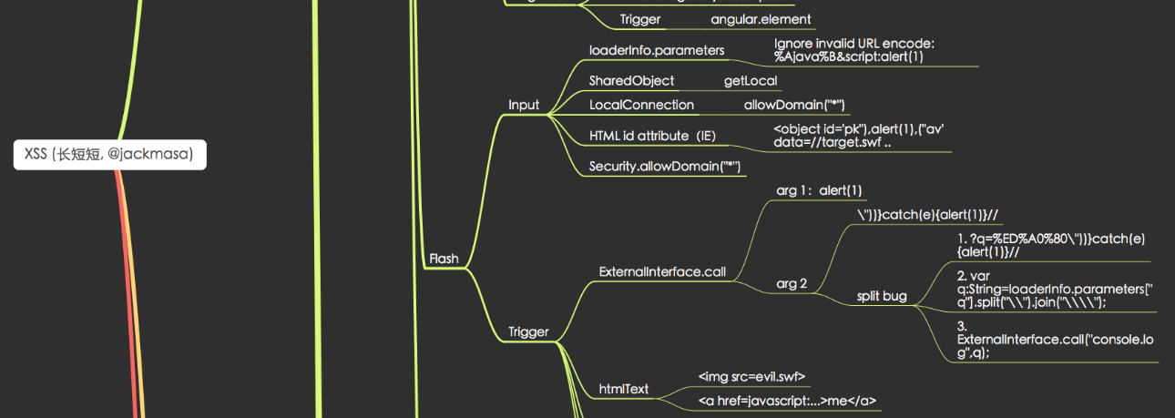
XSS -
Tools
Payloads
https://github.com/fuzzdb-project/fuzzdb
https://github.com/danielmiessler/SecLists
Polyglots
https://github.com/0xsobky/HackVault/wiki/Unleashing-an-Ultimate-XSS-Polyglot
JackMasa’s XSS Mind map
https://github.com/jhaddix/XSS.png

Slide 77
XSS – Defenses
https://www.owasp.org/index.php/Top_10-2017_A7-Cross-Site_Scripting_(XSS)
https://www.owasp.org/index.php/XSS_(Cross_Site_Scripting)_Prevention_Cheat_Sheet
http://cwe.mitre.org/data/definitions/79.html
https://www.owasp.org/index.php/Category:OWASP_Enterprise_Security_API
https://docs.microsoft.com/en-us/dotnet/api/system.web.security.antixss.antixssencoder?view=netframework-4.7.2
https://docs.microsoft.com/en-us/aspnet/core/security/cross-site-scripting?view=aspnetcore-2.1
https://code.google.com/archive/p/domxsswiki/wikis/Introduction.wiki

Slide 78
XSS – Practice
OWASP Broken Web App Project – Source Forge
https://sourceforge.net/projects/owaspbwa/
Vulnerable Web App – College Professor
http://www.vulnerablewebapps.org/
Damn Vulnerable Web Application (DVWA)
http://www.dvwa.co.uk/
Mutillidae - webpwnized/mutillidae
https://github.com/webpwnized/mutillidae

Slide 79
Web Hacking – Training - Paid
PentesterAcademy-
https://www.pentesteracademy.com/
SANS – SEC542: Web App Penetration Testing and Ethical Hacking-
https://www.sans.org/course/web-app-penetration-testing-ethical-hacking
Offensive Security Web Expert -
https://www.offensive-security.com/information-security-certifications/oswe-offensive-security-web-expert/
eLearnSecurity – eWPT
https://www.elearnsecurity.com/certification/
Practical Web Application Penetration Testing - PWAPT
https://www.lanmaster53.com/training/

Slide 80
Web hacking – Training - FREE
YouTube – Web Hacking
Webpwnized
IppSec
Derek Rook
Bugcrowd
LiveOverflow
m4v3r1ck
Adrian Crenshaw
PentestersAcademy
YouTube – Coding
Derek Banas- Language in an hour
Learn To Code – GOLANG
LearnWebCode
SimplyCoded
https://www.hackerone.com/hacker101
https://www.infosecurity-magazine.com/news/hackedu-hackerone-partner-to-offer/

Slide 81
Books
The Web Application Hacker's Handbook: Finding and Exploiting Security Flaws 2nd Edition
The Hacker Playbook 3: Practical Guide To Penetration Testing Paperback – May 2, 2018, recommend 1&2 as well
RTFM – Red Team Field Manual
Metasploit Penetration testers guide
Black Hat Python
Kali Linux Revealed - https://www.kali.org/download-kali-linux-revealed-book/
OWASP Testing guide - https://www.owasp.org/images/1/19/OTGv4.pdf

Slide 82
Contact
Nathan Cooper –
Nathan.cooper@owasp.org
https://www.linkedin.com/in/nathan-cooper-35b0782b/
Joe Oriel –
Joe.oriel@owasp.org
https://www.linkedin.com/in/joseph-oriel-3474a394/
Slides
https://github.com/outofcontrolnate/Central-Pennsylvania--OWASP

